Slide 1

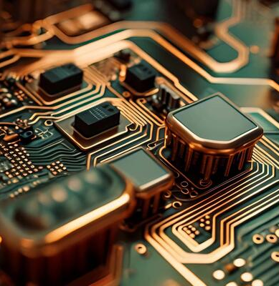
Introduction to Flip-Flops.
Digital Logic and Circuits (section-S)

Slide 2
Group Members:
Name | ID
CHINMOY GUHA | 22-48056-2
SUVRA CHAKRABORTY | 22-48067-2
SAYMA RAHMAN SHANTA | 22-48132-2
MAHNUR BINTE KARIM | 22-48086-2

Slide 3
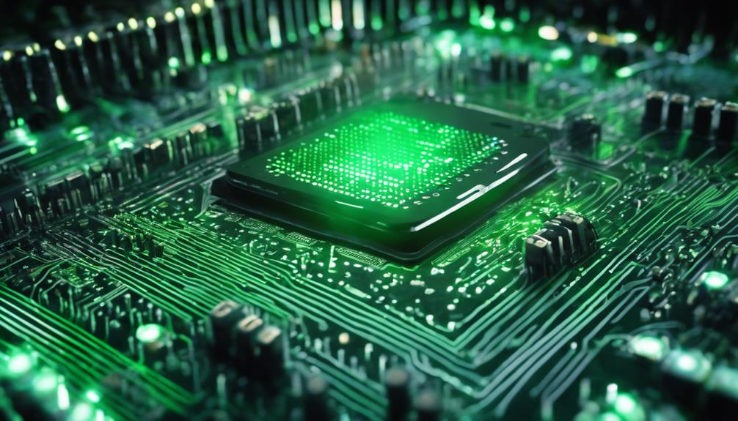
Table of contents
Introduction
Basic Concepts
Types of Flip-Flops
Working Principles
Applications
Conclusion
References

Slide 4
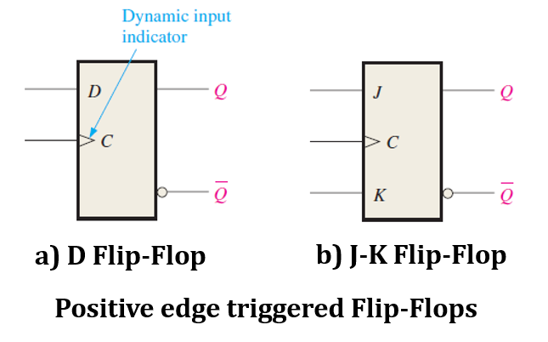
Introduction:
What are Flip-Flops?
Flip-Flops are bistable multivibrators used in digital electronics.
They have two stable states: Set (1) and Reset (0).
They are sequential circuits.
Operate using a clock signal, enabling synchronization in digital systems.
Serve as building blocks for more complex devices like counters, registers, and memory units.

Slide 5
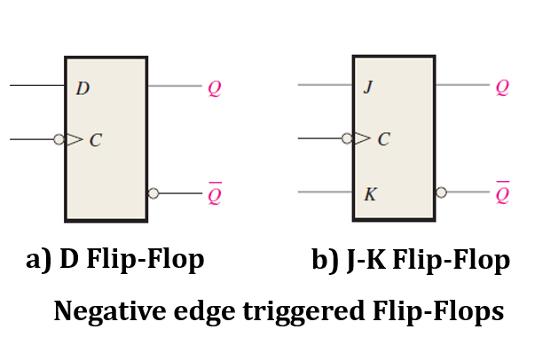
Importance in Digital Electronics
-Flip-Flops enable data storage and processing in sequential logic circuits. - Widely used in applications such as computer registers, communication devices, and control systems. - Play a key role in timing, synchronization, and state representation in digital systems.
Introduction:

Slide 6
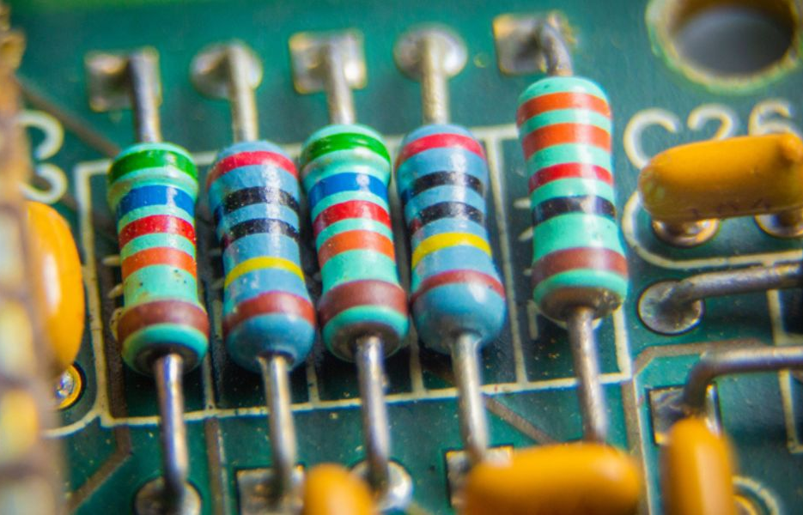
Basic Concepts:
Difference Between Latches and Flip-Flops:
1.**Latches**: Operate asynchronously, changing state immediately with input changes.
2. **Flip-Flops**: Operate synchronously, changing state only on the triggering edge of a clock signal.
3. Flip-Flops are more suitable for clocked systems, while latches are used in specific asynchronous designs.

Slide 7
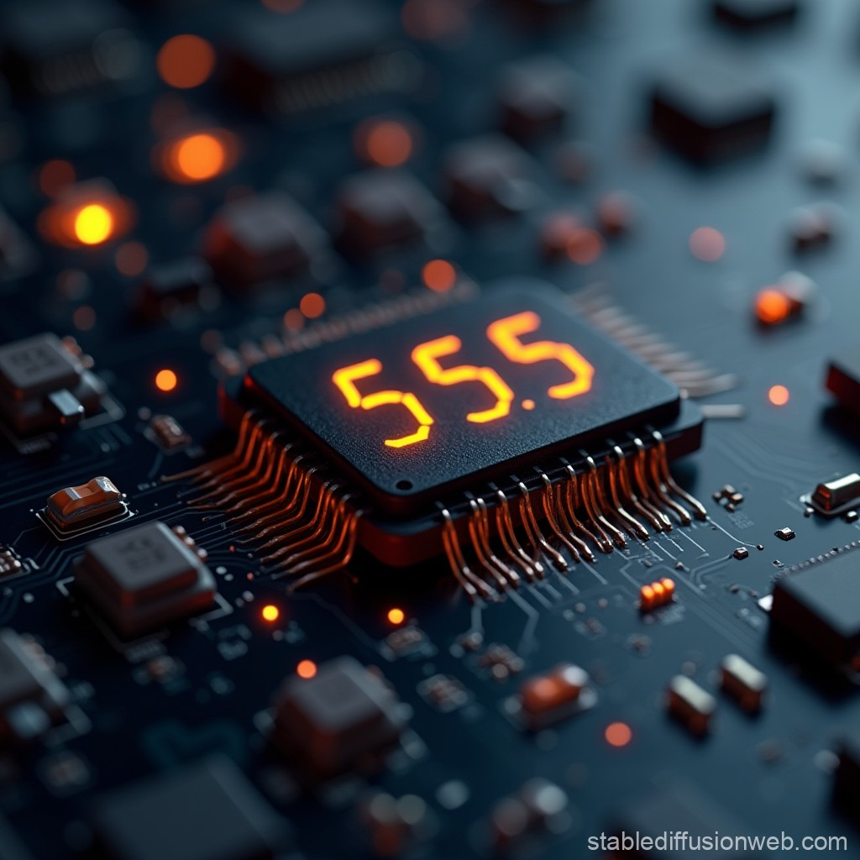
Basic Concepts:
Clock Signal and Edge-Triggering:
A **Clock Signal** is a periodic square wave that drives the operation of sequential circuits.
Flip-Flops use **Edge-Triggering**, responding only to the rising edge (low-to-high transition) or falling edge (high-to-low transition) of the clock signal.
This controlled triggering ensures synchronization in digital systems.
**Positive Edge-Triggered** Flip-Flops activate on the rising edge, while **Negative Edge-Triggered** Flip-Flops activate on the falling edge.

Slide 8
Types of Flip Flops:
SR Flip-Flop (Set-Reset)
-Stores a single bit of data using two inputs: **Set (S)** and **Reset (R)**.
-Output Q is set to 1 when S=1 and R=0, and reset to 0 when S=0 and R=1.
–**Invalid State** occurs when S=1 and R=1 simultaneously.
JK Flip-Flop
-Overcomes the invalid state of SR Flip-Flop with inputs **J** (Set) and **K** (Reset).
-When J=K=1, the output toggles (Q becomes the opposite of its previous state). -Operates on the clock's edge, offering versatility in sequential circuits.
D Flip-Flop (Data or Delay):
-Simplifies the SR Flip-Flop by eliminating the invalid state.
-Has one input: **D (Data)** and a clock signal.
-Transfers the input D to output Q on the triggering edge of the clock.

Slide 9
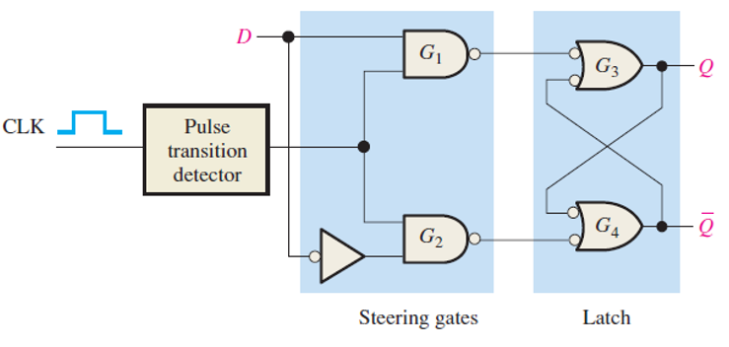
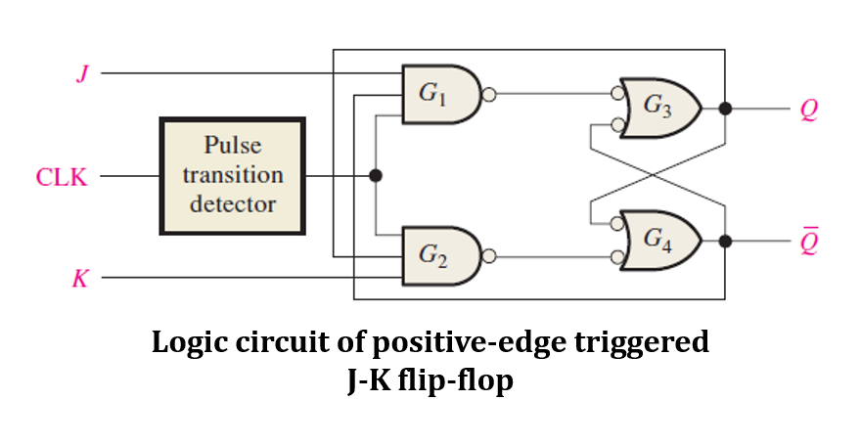
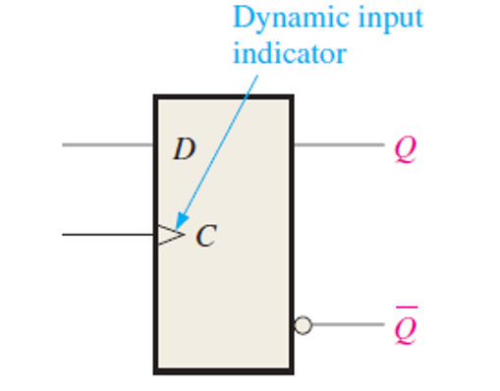
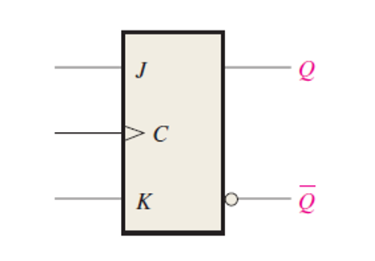
J,K-Flip Flops
D-Flip Flops

Slide 10
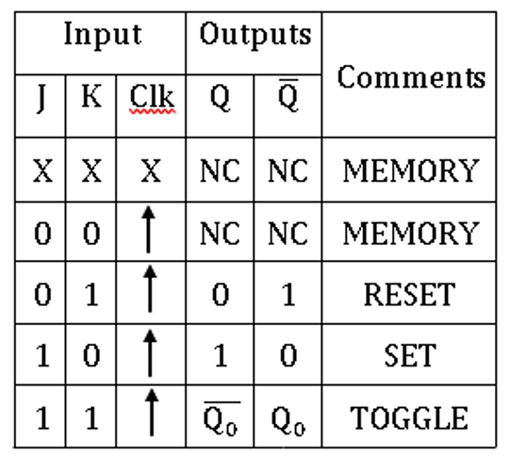
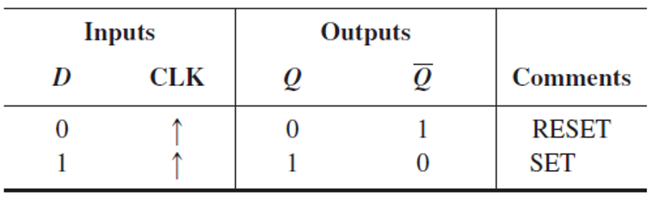
Working Principle:
1.Truth Tables: - **Truth Table** defines the behavior of a Flip-Flop based on its inputs and clock signal.
- Example:
Truth table of a D Flip-Flop
Truth table of a J,K Flip-Flop

Slide 11
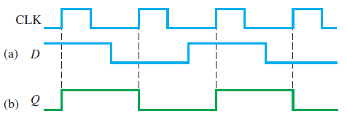
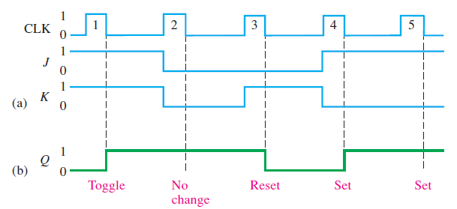
Working Principle:
2. Timing Diagrams: 1. **Timing Diagram** illustrates the relationship between inputs, clock signal, and output over time.
2. Helps in understanding when the Flip-Flop changes its state during the clock cycle. 3. Critical for analyzing synchronization in digital circuits.
Timing Diagram of a D Flip-Flop
Timing Diagram of a J,K Flip-Flop

Slide 12
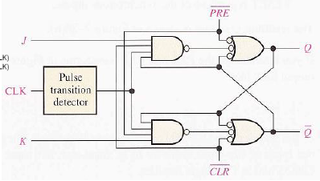
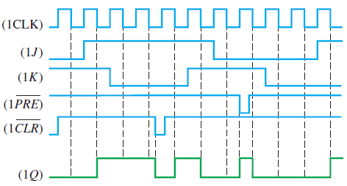
Working Principle:
3. Flip-Flops with Asynchronous Inputs:
Flip-flops have asynchronous inputs in addition to synchronous inputs.
Asynchronous inputs affect the output regardless of the clock edge.
Two common asynchronous inputs are Preset and Clear.
Both Preset and Clear are active-LOW inputs.
When Preset is LOW:
-It sets the flip-flop, overriding synchronous inputs.
When Clear is LOW: -It resets the flip-flop, overriding synchronous inputs.
J,K flip Flop with PRE and CLR
Timing Diagram of a J,K Flip-Flop with asynchronous input

Slide 13
Applications of Flip-Flops:
1. Counters: Flip-flops are the fundamental building blocks for counters, which are used to count events, pulses, or time intervals in digital systems.
Examples include binary counters, up/down counters, and decade counters, sequence counters.
3. Frequency Dividers: Flip-flops can divide input frequencies by 2, 4, or more to generate lower frequency signals. Widely used in clock generation and synchronization circuits.
2. Registers: Used in registers for temporary data storage in microprocessors and digital systems. Common types include shift registers, which can shift data serially or in parallel.

Slide 14
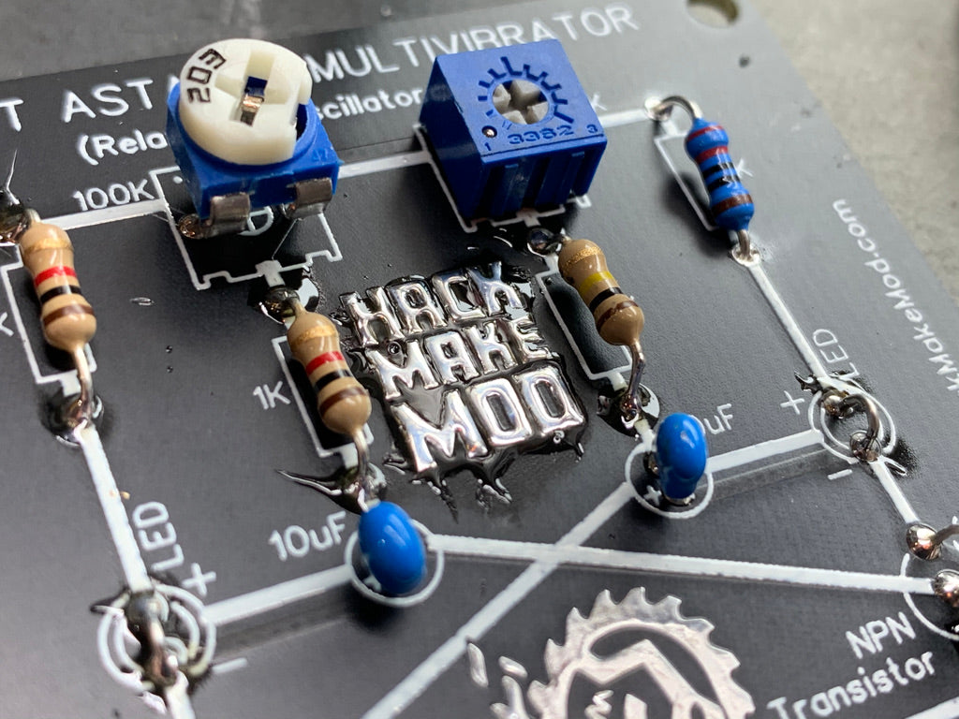
Conclusion:
Flip-flops are essential components in digital electronics, serving as fundamental building blocks for sequential circuits.
They operate using clock signals and come in various types, including SR, D, JK, and T flip-flops, each with unique characteristics and applications.
Emerging technologies like quantum computing and AI may incorporate evolved forms of flip-flops for data processing and control.

Slide 15
References:
M. Morris Mano, Michael D. Ciletti, “Digital Design” (6th Edition)
William H. Gothmann, “Digital Electronics: An introduction to Theory and Practice”
H. Taub and D. Schilling, “Digital Integrated Circuits”.
Horowitz, P., & Hill, W. (2015). The Art of Electronics (3rd Edition). Cambridge University Press.

Slide 16
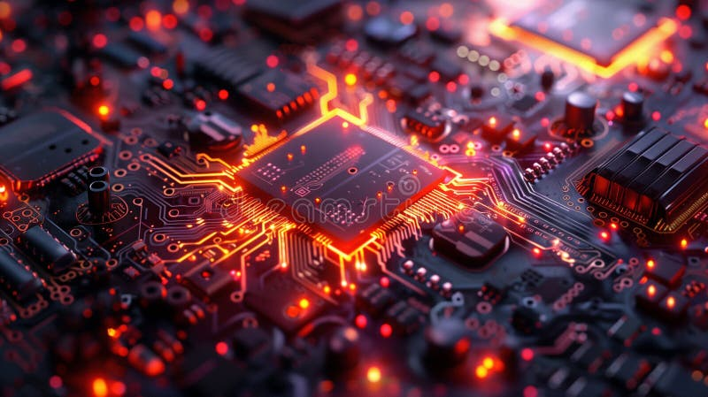
Thanks for tuning in! ☺

